Slide 1
Taxes In the DSGE models
毛盛志
经济学院
2022年10月19日

Slide 2
Introduction
Dynamic stochastic general equilibrium (DSGE) Model
动态 随机 一般 均衡 模型
DSGE econometric modelling applies general equilibrium theory and microeconomic principles in a tractable manner to postulate economic phenomena, such as economic growth and business cycles, as well as economic policy effects and market shocks.
Agents
Households
Firms
The Government
Banking system
…

Slide 3
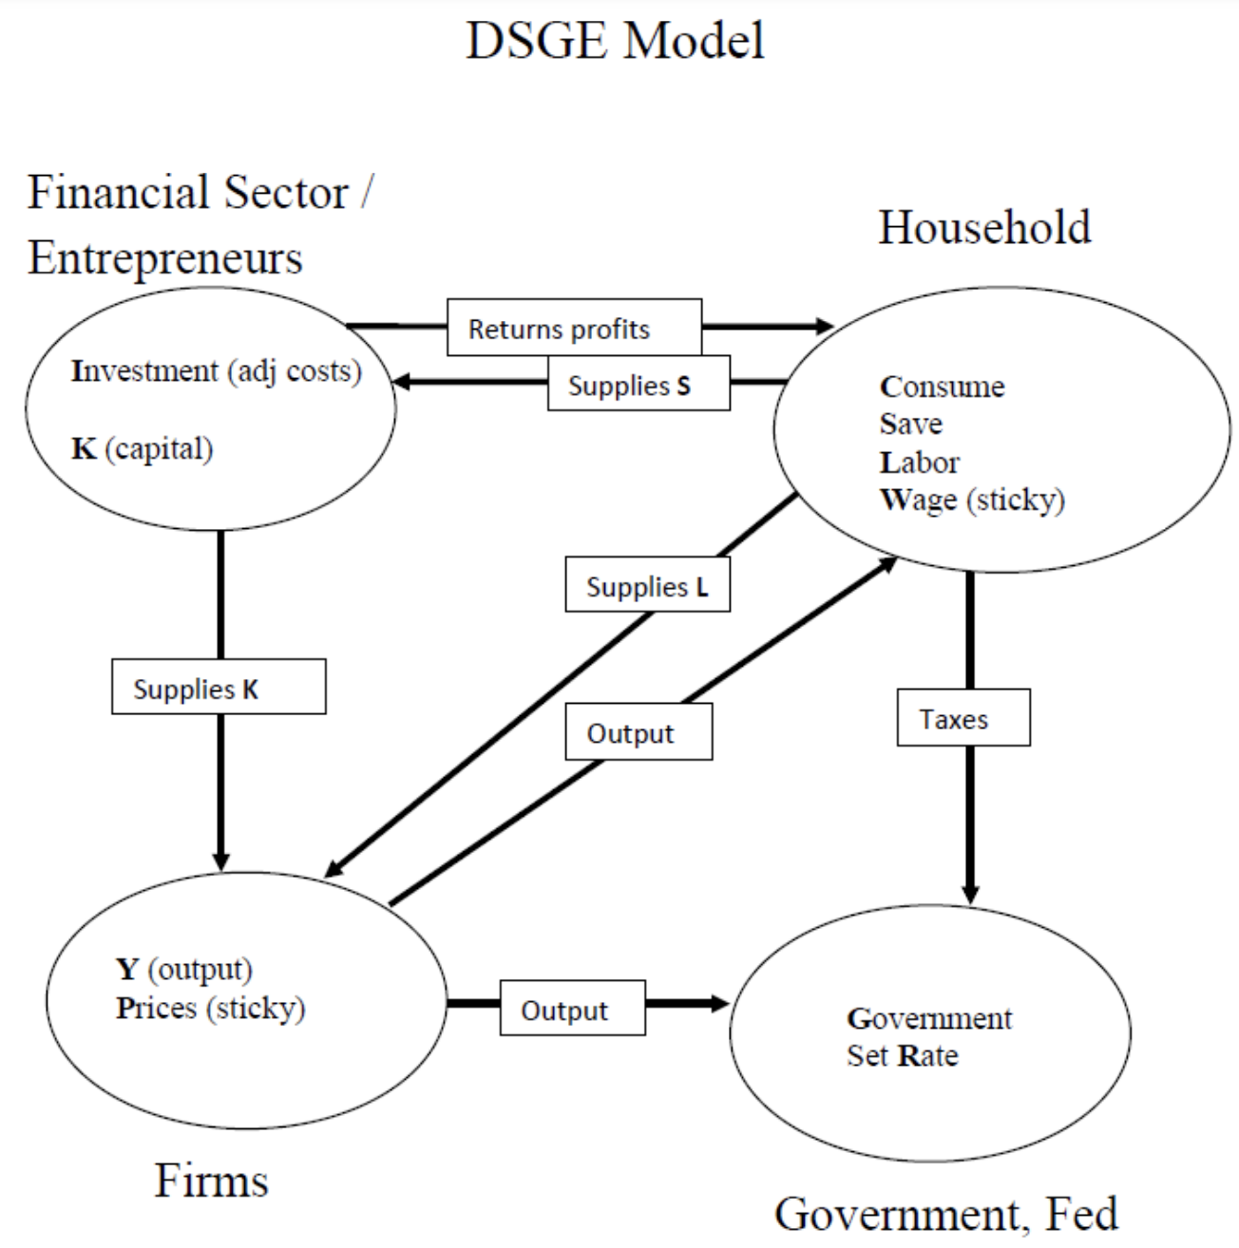

Slide 4

https://sci-hub.wf/10.1257/jep.32.3.113
JEP, 2018

Slide 5


Slide 6
Introduction
Two types of taxes
Lump-sum taxes (一次性总付税)
non-distortionary taxes and do not change households and firms decisions.
Distortionary taxes
they affect the market price of goods and production inputs, and hence change private agents’ economic decisions.
consumption tax
labor income tax
capital income tax

Slide 7
Introduction
DSGE models help us to study different interesting questions regarding taxation.
We can use this model to compute Laffer curves for the economy
The relationship between fiscal revenues and the tax rate in the steady-state.
We can study the dynamics effects of a change in the tax rates
changes can be either permanent or temporary and anticipated or unanticipated.
We will study the effects of an aggregate productivity (TFP) shock in an economy with distortionary taxes.

Slide 8
Roadmap
Section 2 defines the tax structure of the economy and how taxes can be introduced in the DSGE model.
Section 3 presents the model with three taxes:
consumption tax, labor income tax and capital income tax.
Section 4 presents the equations of the model and the calibration exercise.
Section 5 estimates steady state Laffer curves.
Section 6 studies the effect of a change in taxes, e.g., consumption tax.
Section 7 studies the dynamic effects of a TFP shock.
Section 8 presents some conclusions.

Slide 9
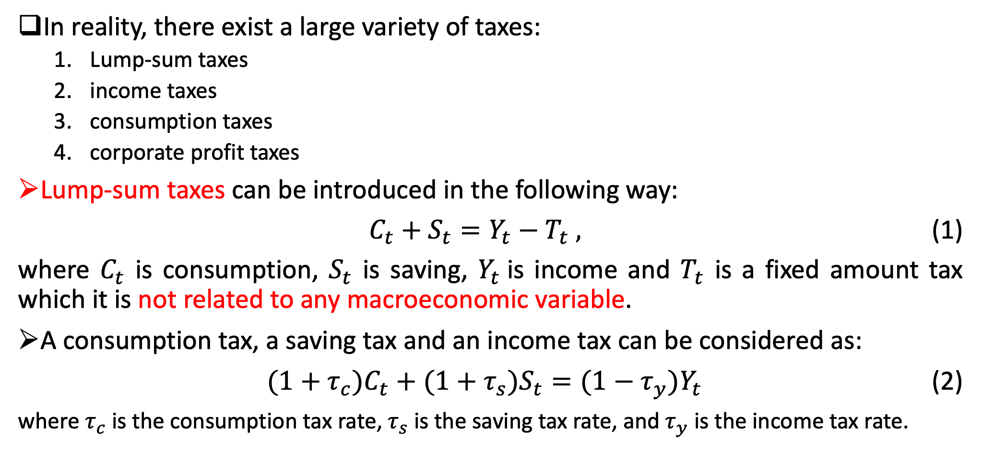
2. Taxes
In reality, there exist a large variety of taxes:
Lump-sum taxes
income taxes
consumption taxes
corporate profit taxes
Lump-sum taxes can be introduced in the following way:
$C_{t}+S_{t}=Y_{t}−T_{t} ,$ (1)
where $C_{t}$ is consumption, $S_{t}$ is saving, $Y_{t}$is income and $T_{t}$ is a fixed amount tax which it is not related to any macroeconomic variable.
A consumption tax, a saving tax and an income tax can be considered as:
$(1+τ_{c})C_{t}+(1+τ_{s})S_{t}=(1−τ_{y})Y_{t}$ (2)
where $τ_{c}$is the consumption tax rate,$τ_{s}$is the saving tax rate, and $τ_{y}$ is the income tax rate.

Slide 10
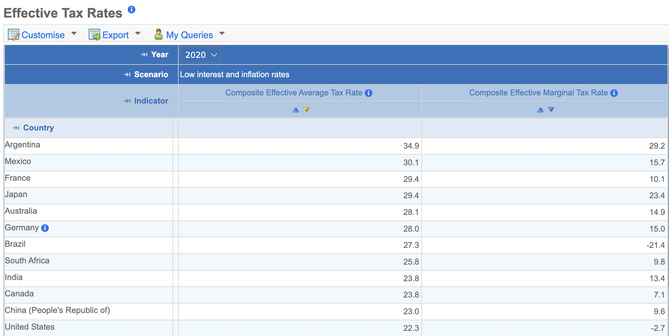
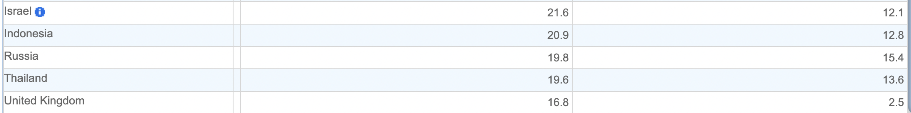
https://stats.oecd.org/

Slide 11
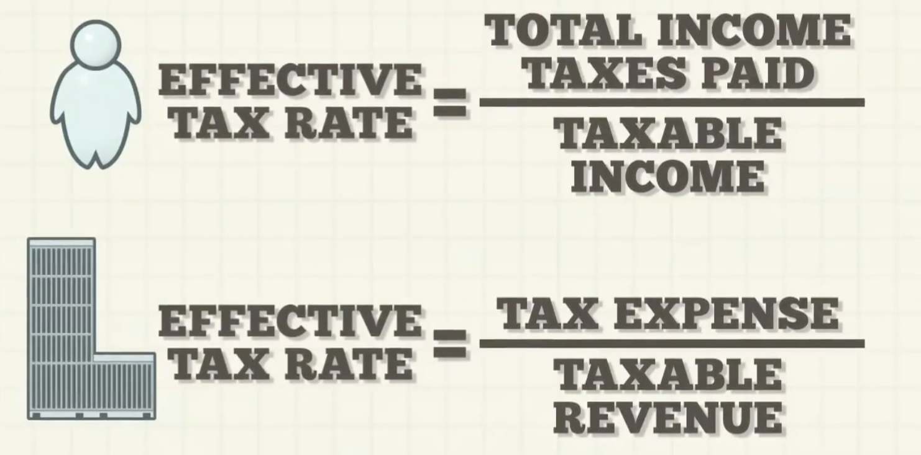

Slide 12
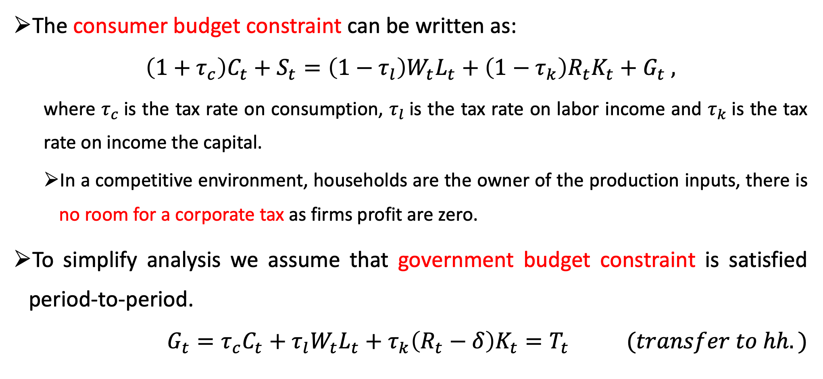
2. Taxes
The consumer budget constraint can be written as:
$$\left(1+τ_{c}\right)C_{t}+S_{t}=\left(1−τ_{l}\right)W_{t}L_{t}+\left(1−τ_{k}\right)R_{t}K_{t}+G_{t} ,$$
where $τ_{c}$is the tax rate on consumption, $τ_{l}$is the tax rate on labor income and $τ_{k}$is the tax rate on income the capital.
In a competitive environment, households are the owner of the production inputs, there is no room for a corporate tax as firms profit are zero.
To simplify analysis we assume that government budget constraint is satisfied period-to-period.
$$G_{t}=τ_{c}C_{t}+τ_{l}W_{t}L_{t}+τ_{k}\left(R_{t}−δ\right)K_{t}=T_{t} (transfer to hh.)$$

Slide 13
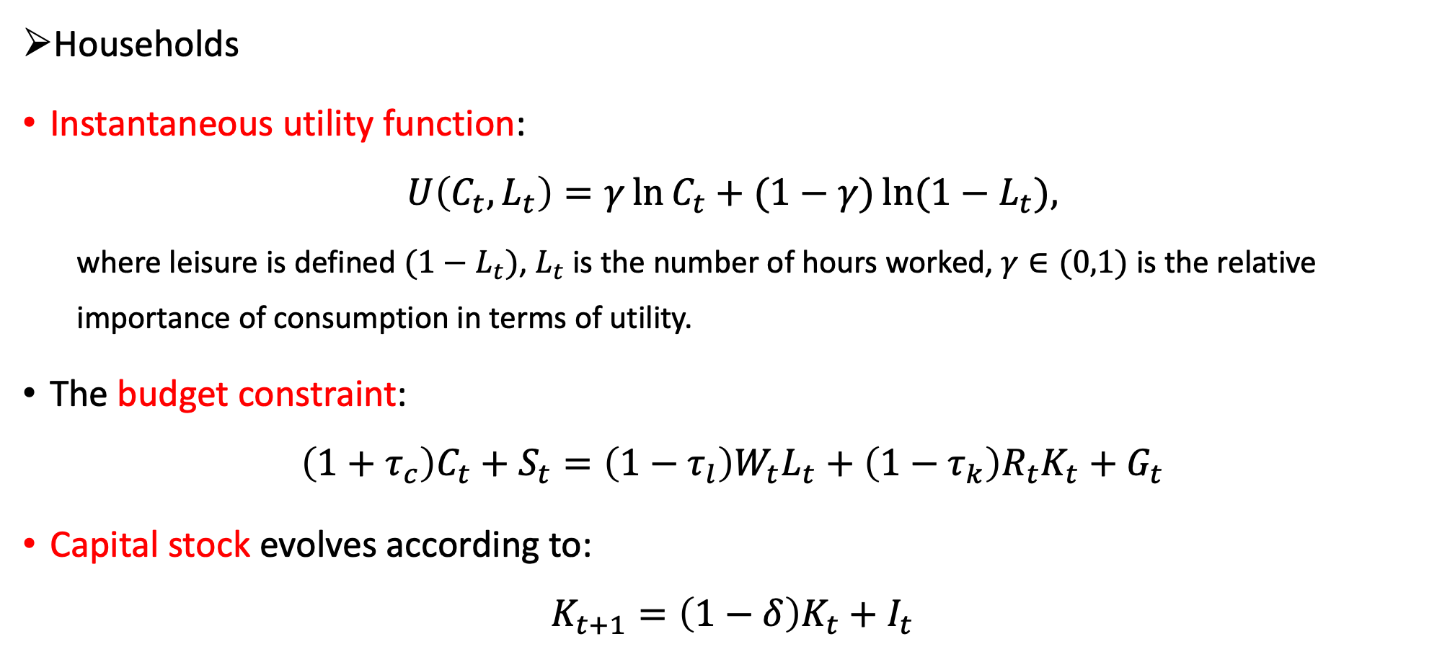
3. A DSGE model with taxes
Households
Instantaneous utility function:
$$U\left(C_{t}, L_{t}\right)=γ\ln{C_{t}}+(1−γ)\ln{(1−L_{t}}),$$
where leisure is defined $(1−L_{t})$, $L_{t}$ is the number of hours worked, $γ∈(0,1)$ is the relative importance of consumption in terms of utility.
The budget constraint:
$$\left(1+τ_{c}\right)C_{t}+S_{t}=\left(1−τ_{l}\right)W_{t}L_{t}+\left(1−τ_{k}\right)R_{t}K_{t}+G_{t}$$
Capital stock evolves according to:
$$K_{t+1}=\left(1−δ\right)K_{t}+I_{t}$$

Slide 14
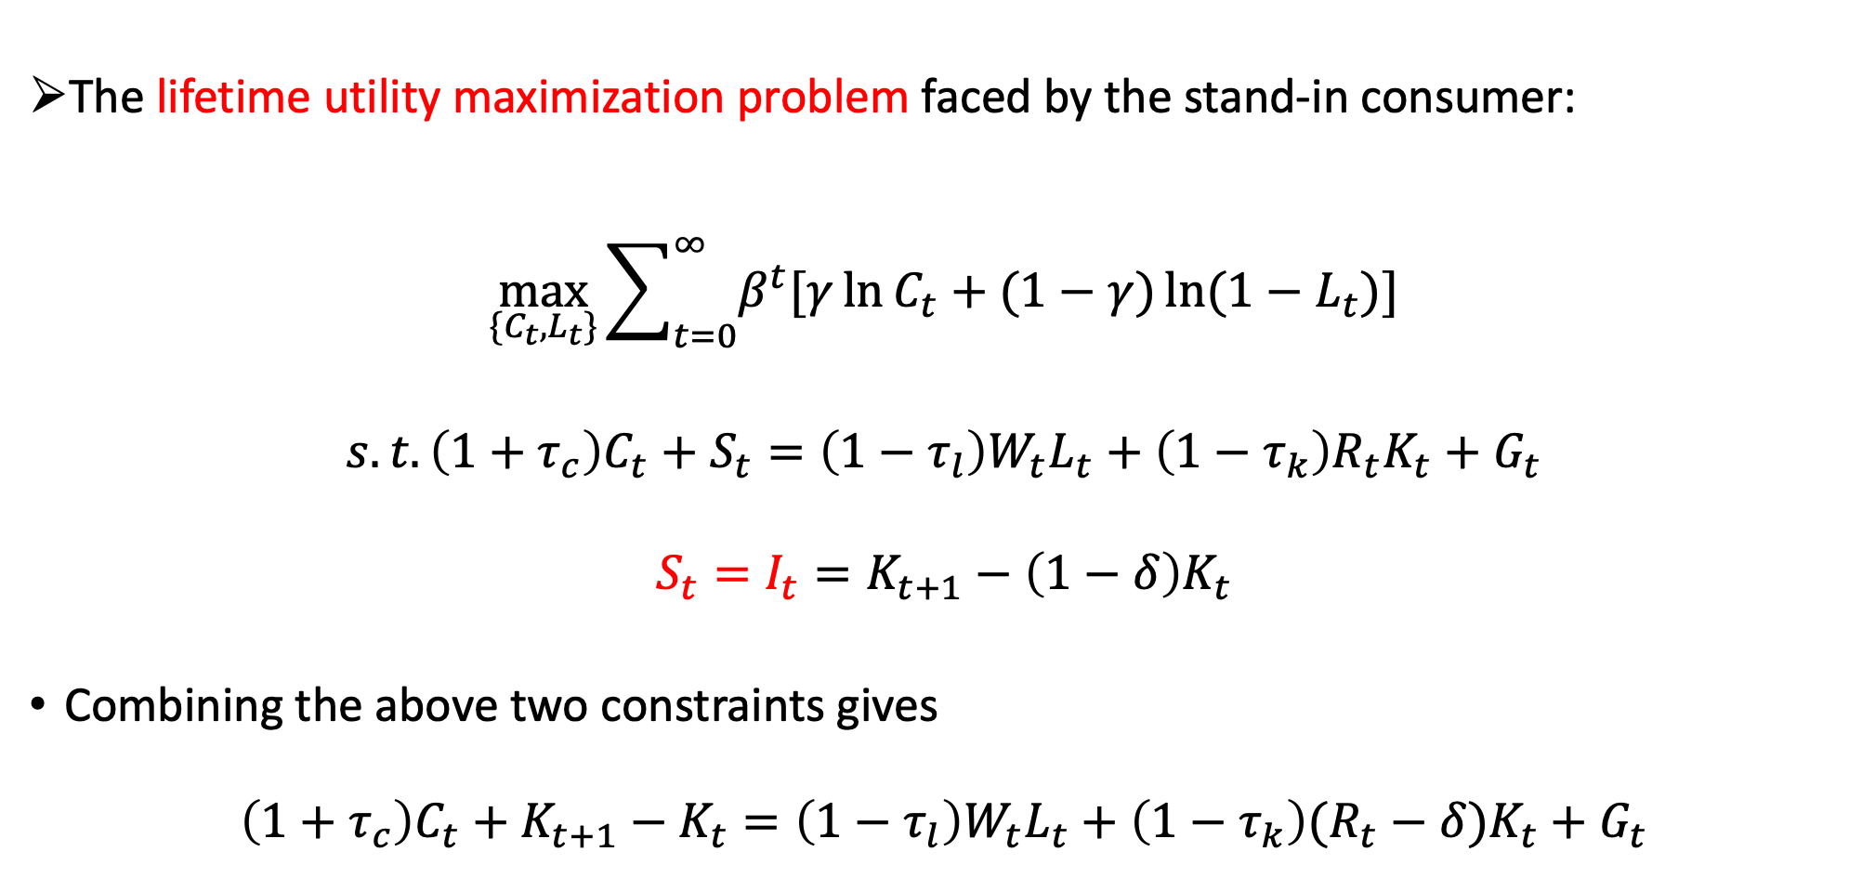
3. A DSGE model with taxes
The lifetime utility maximization problem faced by the stand-in consumer:
$$\max_{\{C_{t},L_{t}\}}{\sum_{t=0}^{∞}{β^{t}[γ\ln{C_{t}}+(1−γ)\ln{(1−L_{t}})]}}$$
$$s.t.\left(1+τ_{c}\right)C_{t}+S_{t}=\left(1−τ_{l}\right)W_{t}L_{t}+\left(1−τ_{k}\right)R_{t}K_{t}+G_{t}$$
$$S_{t}=I_{t}=K_{t+1}−\left(1−δ\right)K_{t}$$
Combining the above two constraints gives
$$\left(1+τ_{c}\right)C_{t}+K_{t+1}−K_{t}=\left(1−τ_{l}\right)W_{t}L_{t}+\left(1−τ_{k}\right)(R_{t}−δ)K_{t}+G_{t}$$

Slide 15
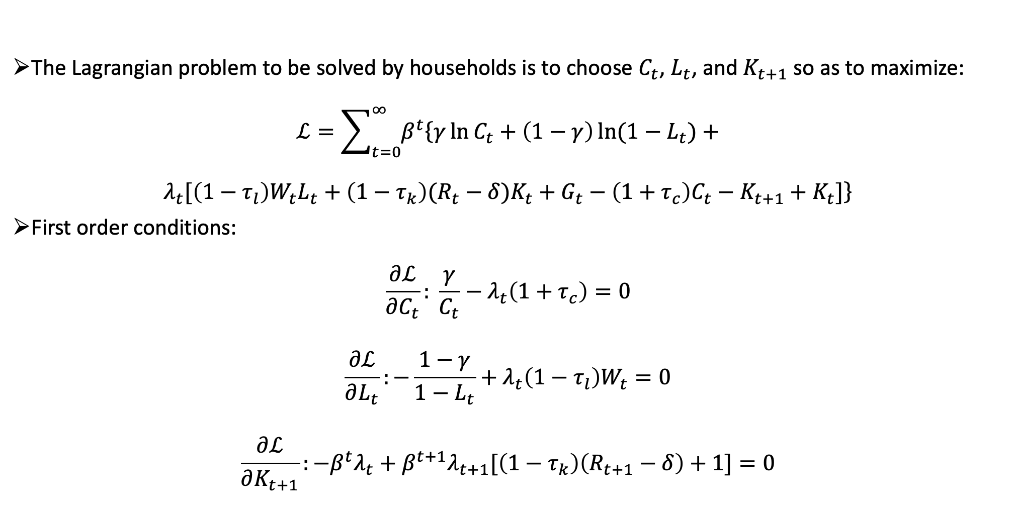
3. A DSGE model with taxes
The Lagrangian problem to be solved by households is to choose $C_{t}$, $L_{t}$, and $K_{t+1}$ so as to maximize:
$$ℒ=\sum_{t=0}^{∞}{β^{t}\left\{γ\ln{C_{t}}+\left(1−γ\right)\ln{(1−L_{t}})\right.+}$$
$$\left.λ_{t}[\left(1−τ_{l}\right)W_{t}L_{t}+\left(1−τ_{k}\right)(R_{t}−δ)K_{t}+G_{t}−\left(1+τ_{c}\right)C_{t}−K_{t+1}+K_{t}]\right\}$$
First order conditions:
$$\frac{∂ℒ}{∂C_{t}}: \frac{γ}{C_{t}}−λ_{t}\left(1+τ_{c}\right)=0$$
$$\frac{∂ℒ}{∂L_{t}}:−\frac{1−γ}{1−L_{t}}+λ_{t}\left(1−τ_{l}\right)W_{t}=0$$
$$\frac{∂ℒ}{∂K_{t+1}}:−β^{t}λ_{t}+β^{t+1}λ_{t+1}[\left(1−τ_{k}\right)\left(R_{t+1}−δ\right)+1]=0$$

Slide 16
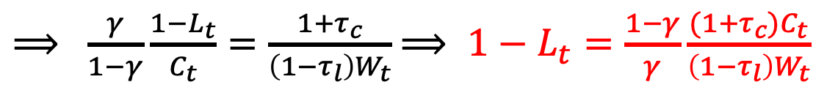
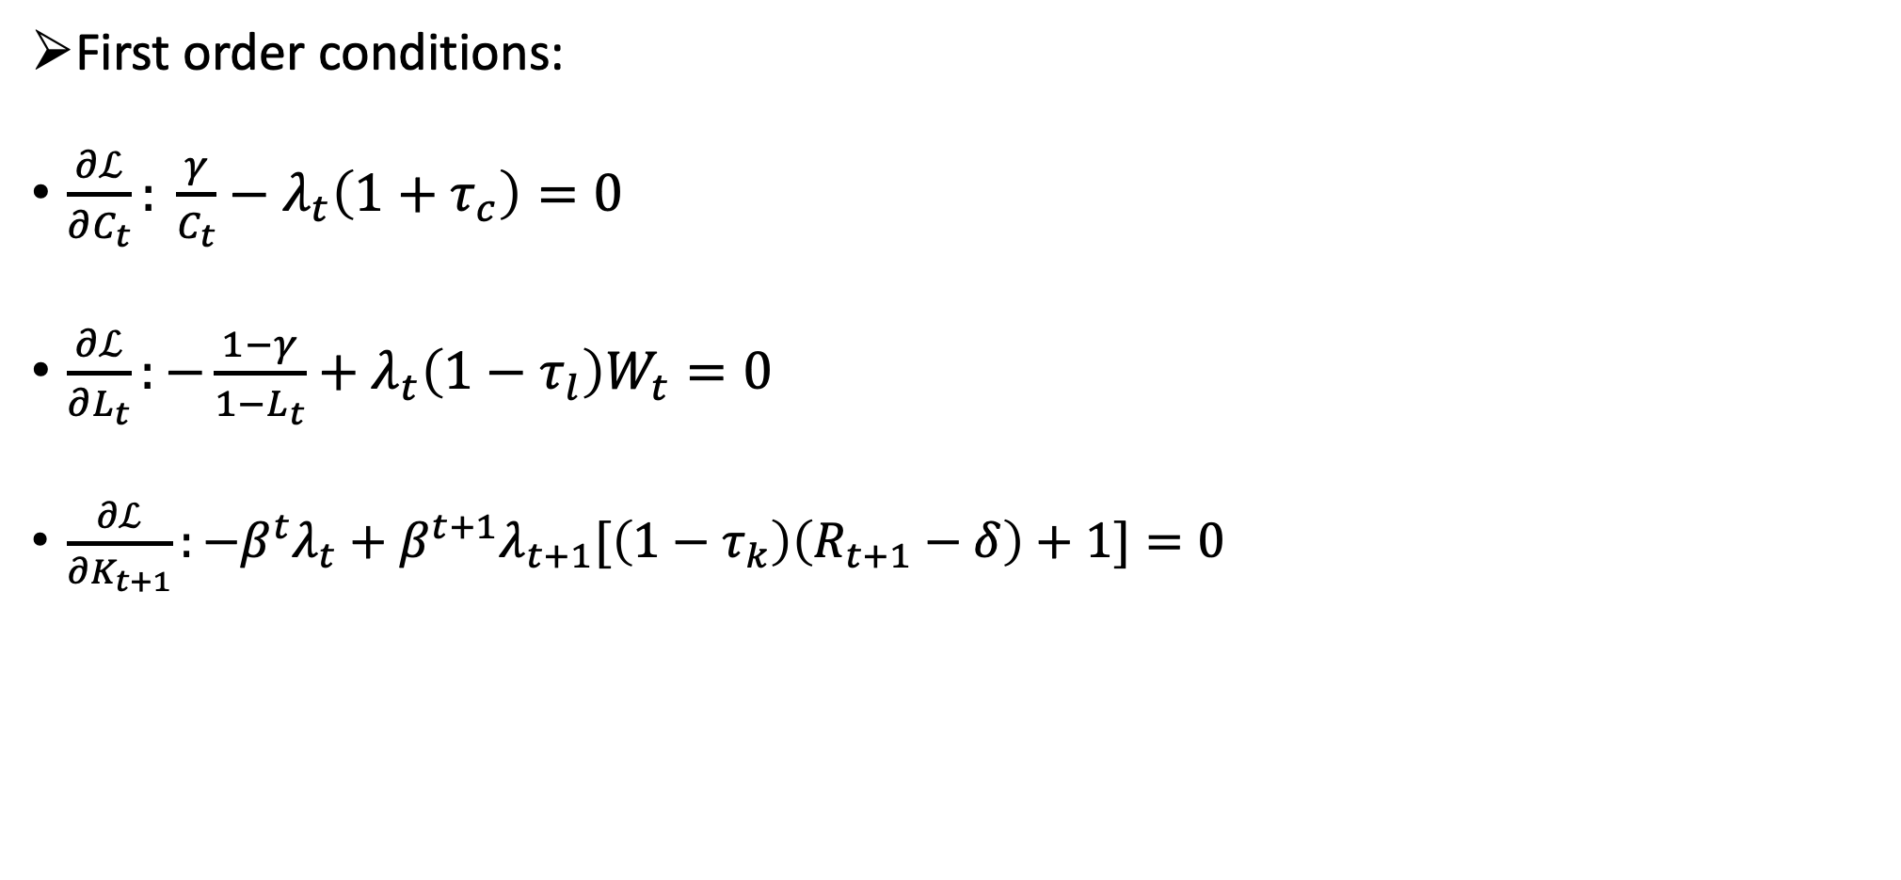
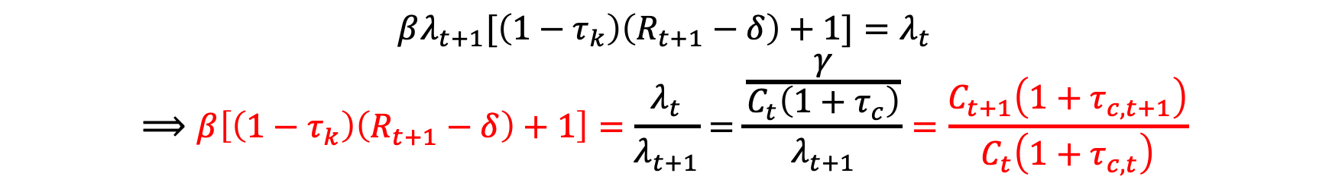
3. A DSGE model with taxes
First order conditions:
$\frac{∂ℒ}{∂C_{t}}: \frac{γ}{C_{t}}−λ_{t}\left(1+τ_{c}\right)=0$
$\frac{∂ℒ}{∂L_{t}}:−\frac{1−γ}{1−L_{t}}+λ_{t}\left(1−τ_{l}\right)W_{t}=0$
$\frac{∂ℒ}{∂K_{t+1}}:−β^{t}λ_{t}+β^{t+1}λ_{t+1}[\left(1−τ_{k}\right)\left(R_{t+1}−δ\right)+1]=0$
$⟹ \frac{γ}{1−γ}\frac{1−L_{t}}{C_{t}}=\frac{1+τ_{c}}{\left(1−τ_{l}\right)W_{t}}$ $⟹ 1−L_{t}=\frac{1−γ}{γ}\frac{(1+τ_{c})C_{t}}{\left(1−τ_{l}\right)W_{t}}$
（闲暇）
$$βλ_{t+1}[\left(1−τ_{k}\right)\left(R_{t+1}−δ\right)+1]=λ_{t}$$
$$⟹β\left[\left(1−τ_{k}\right)\left(R_{t+1}−δ\right)+1\right]=\frac{λ_{t}}{λ_{t+1}}=\frac{\frac{γ}{C_{t}\left(1+τ_{c}\right)}}{λ_{t+1}}=\frac{C_{t+1}\left(1+τ_{c,t+1}\right)}{C_{t}\left(1+τ_{c,t}\right)}$$

Slide 17

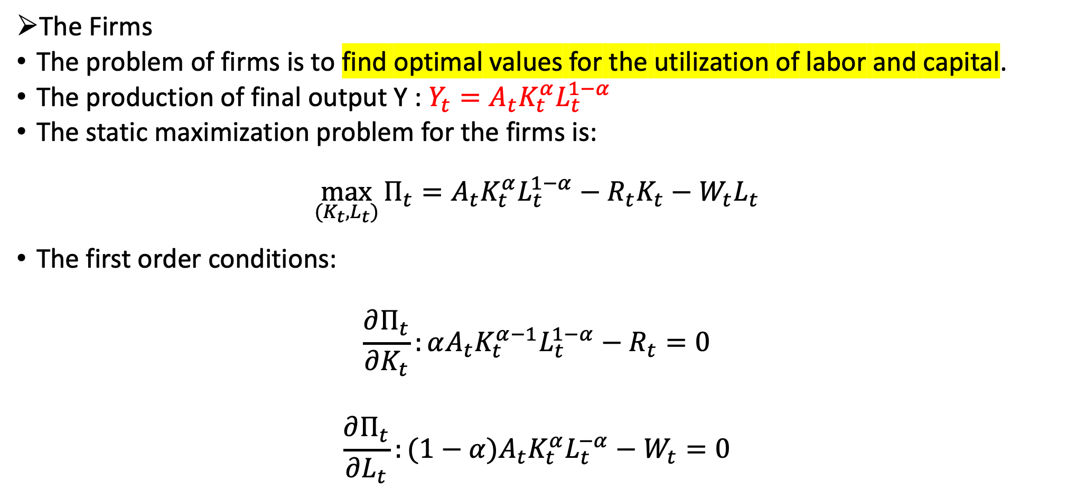
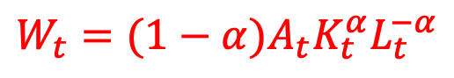
3. A DSGE model with taxes
The Firms
The problem of firms is to find optimal values for the utilization of labor and capital.
The production of final output Y : $Y_{t}=A_{t}K_{t}^{α}L_{t}^{1−α}$
The static maximization problem for the firms is:
$$\max_{(K_{t},L_{t})}{Π_{t}=A_{t}K_{t}^{α}L_{t}^{1−α}−R_{t}K_{t}−W_{t}L_{t}}$$
The first order conditions:
$$\frac{∂Π_{t}}{∂K_{t}}:αA_{t}K_{t}^{α−1}L_{t}^{1−α}−R_{t}=0$$
$$\frac{∂Π_{t}}{∂L_{t}}:(1−α)A_{t}K_{t}^{α}L_{t}^{−α}−W_{t}=0$$
$$R_{t}=αA_{t}K_{t}^{α−1}L_{t}^{1−α}$$
$$W_{t}=(1−α)A_{t}K_{t}^{α}L_{t}^{−α}$$

Slide 18
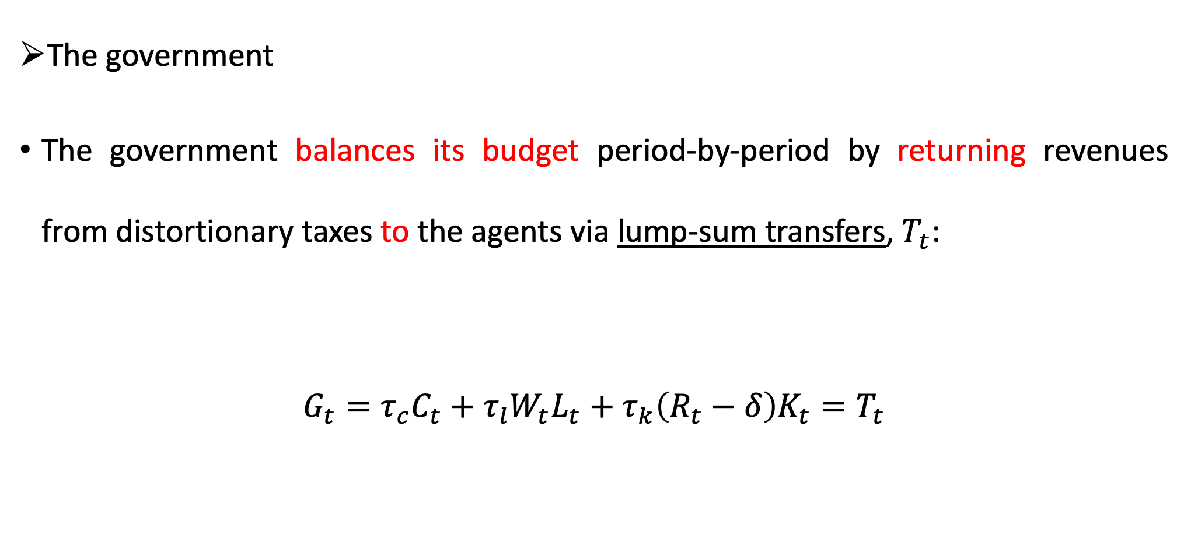
3. A DSGE model with taxes
The government
The government balances its budget period-by-period by returning revenues from distortionary taxes to the agents via lump-sum transfers, $T_{t}$:
$$G_{t}=τ_{c}C_{t}+τ_{l}W_{t}L_{t}+τ_{k}\left(R_{t}−δ\right)K_{t}=T_{t}$$

Slide 19
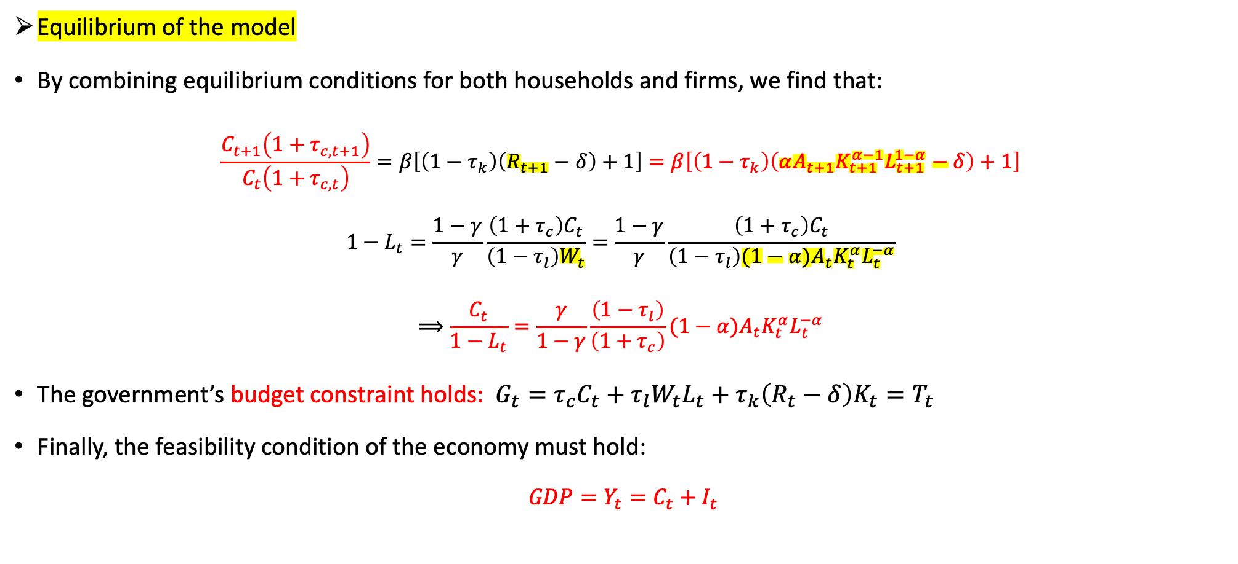
3. A DSGE model with taxes
Equilibrium of the model
By combining equilibrium conditions for both households and firms, we find that:
$$\frac{C_{t+1}\left(1+τ_{c,t+1}\right)}{C_{t}\left(1+τ_{c,t}\right)}=β\left[\left(1−τ_{k}\right)\left(R_{t+1}−δ\right)+1\right]=β\left[\left(1−τ_{k}\right)\left(αA_{t+1}K_{t+1}^{α−1}L_{t+1}^{1−α}−δ\right)+1\right]$$
$$1−L_{t}=\frac{1−γ}{γ}\frac{\left(1+τ_{c}\right)C_{t}}{\left(1−τ_{l}\right)W_{t}}=\frac{1−γ}{γ}\frac{\left(1+τ_{c}\right)C_{t}}{\left(1−τ_{l}\right)(1−α)A_{t}K_{t}^{α}L_{t}^{−α}}$$
$$⟹\frac{C_{t}}{1−L_{t}}=\frac{γ}{1−γ}\frac{\left(1−τ_{l}\right)}{\left(1+τ_{c}\right)}(1−α)A_{t}K_{t}^{α}L_{t}^{−α}$$
The government’s budget constraint holds: $G_{t}=τ_{c}C_{t}+τ_{l}W_{t}L_{t}+τ_{k}\left(R_{t}−δ\right)K_{t}=T_{t}$
Finally, the feasibility condition of the economy must hold:
$GDP=Y_{t}=C_{t}+I_{t}$
1
2
3
4

Slide 20
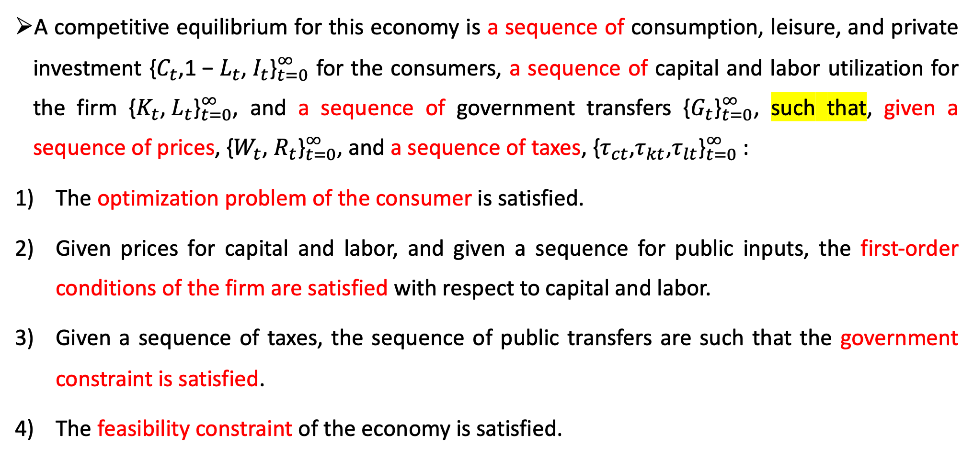
Competitive equilibrium
A competitive equilibrium for this economy is a sequence of consumption, leisure, and private investment ${\text{\{}C_{t}\text{,1 − }L_{t}\text{, }I_{t}\text{\}}}_{t=0}^{∞}$ for the consumers, a sequence of capital and labor utilization for the firm ${\text{\{}K_{t}\text{,} L_{t}\text{\}}}_{t=0}^{∞}$, and a sequence of government transfers ${\text{\{}G_{t}\text{\}}}_{t=0}^{∞}$, such that, given a sequence of prices, ${\text{\{}W_{t}\text{,} R_{t}\text{\}}}_{t=0}^{∞}$, and a sequence of taxes, ${\text{\{}τ_{ct}\text{,}τ_{kt}\text{,}τ_{lt}\text{\}}}_{t=0}^{∞}$:
The optimization problem of the consumer is satisfied.
Given prices for capital and labor, and given a sequence for public inputs, the first-order conditions of the firm are satisfied with respect to capital and labor.
Given a sequence of taxes, the sequence of public transfers are such that the government constraint is satisfied.
The feasibility constraint of the economy is satisfied.

Slide 21
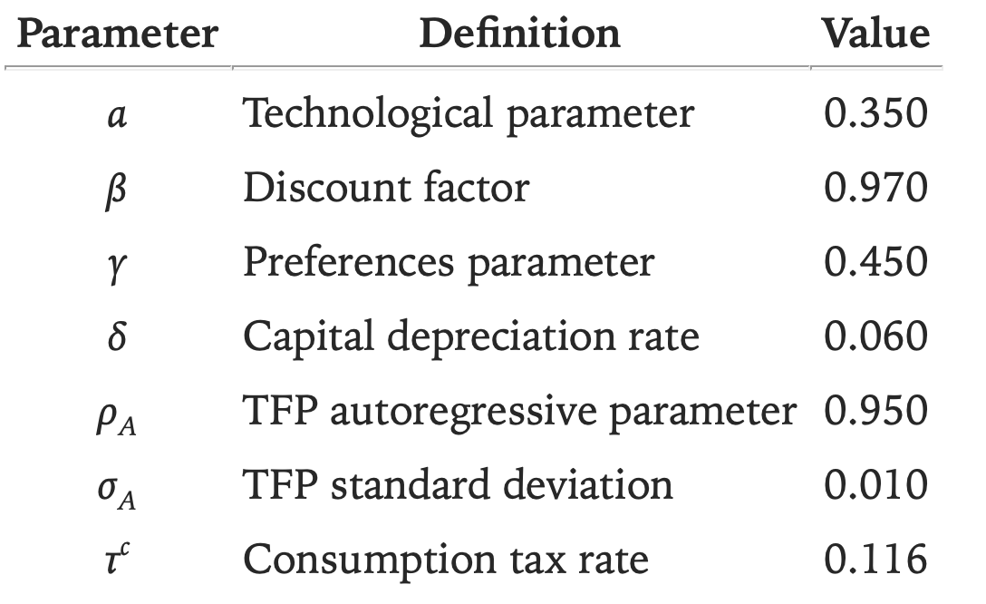
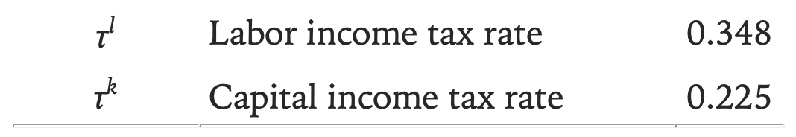
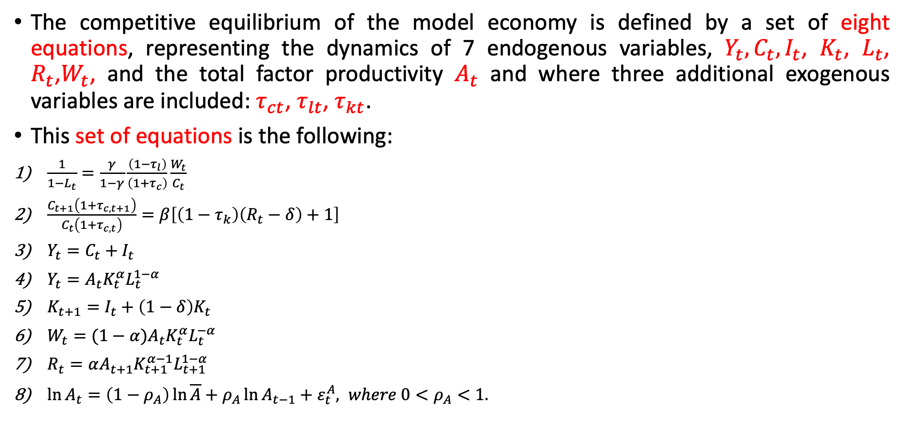
4. Equations of the model and calibration
The competitive equilibrium of the model economy is defined by a set of eight equations, representing the dynamics of 7 endogenous variables, $Y_{t}, C_{t}, I_{t}$, $K_{t}$, $L_{t}$, $R_{t}$,$W_{t}$, and the total factor productivity $A_{t}$ and where three additional exogenous variables are included: $τ_{ct}$, $τ_{lt}$, $τ_{kt}$.
This set of equations is the following:
$\frac{1}{1−L_{t}}=\frac{γ}{1−γ}\frac{\left(1−τ_{l}\right)}{\left(1+τ_{c}\right)}\frac{W_{t}}{C_{t}}$
$\frac{C_{t+1}\left(1+τ_{c,t+1}\right)}{C_{t}\left(1+τ_{c,t}\right)}=β\left[\left(1−τ_{k}\right)\left(R_{t}−δ\right)+1\right]$
$Y_{t}=C_{t}+I_{t}$
$Y_{t}=A_{t}K_{t}^{α}L_{t}^{1−α}$
$K_{t+1}=I_{t}+\left(1−δ\right)K_{t}$
$W_{t}=(1−α)A_{t}K_{t}^{α}L_{t}^{−α}$
$R_{t}=αA_{t+1}K_{t+1}^{α−1}L_{t+1}^{1−α}$
$\ln{A_{t}}=\left(1−ρ_{A}\right)\ln{\overline{A}}+ρ_{A}\ln{A_{t−1}}+ε_{t}^{A}, where {0<ρ}_{A}<1.$
The model parameters to be calibrated are:

Slide 22
4. Equations of the model and calibration
In macroeconomics, calibration is a strategy for finding numerical values for the parameters of artificial economic worlds (i.e., models).
A model is calibrated when its parameters are quantified from casual empiricism or unrelated economic studies or are chosen to guarantee that the model mimics some particular feature of the historical data.
After calibration, you can rerun your model with those parameter values and see the performance of potential policy shocks.

Slide 23
5. The Laffer Curve
The Laffer curve refers to the relationship between the level of taxes and the level of fiscal revenues for an economy.
If taxes are zero, it is no doubts that the level of fiscal revenues will also be zero.
The same would occur in the extreme case in which the (income) tax rate is 100%, since in this case the activity level would be zero:
Who is willing to work (freely) when the government takes all that is produced?
The importance of the Laffer curve lies in the fact that
It is an essential tool for studying the impact of tax changes on fiscal revenues.

Slide 24
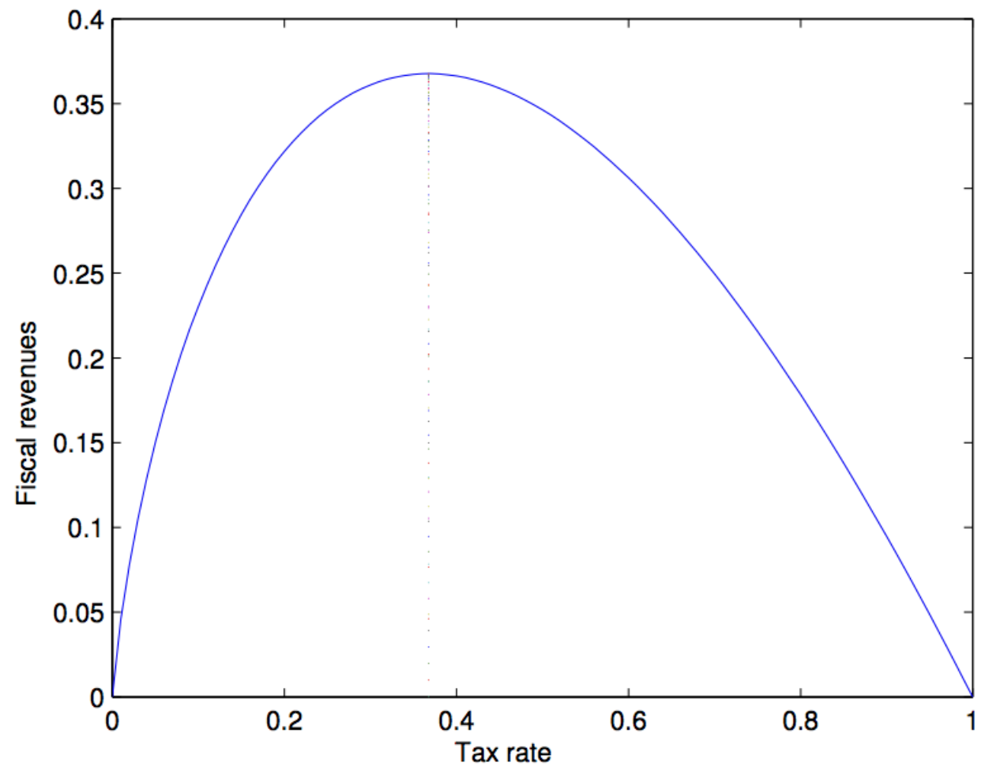
5. The Laffer Curve

Slide 25
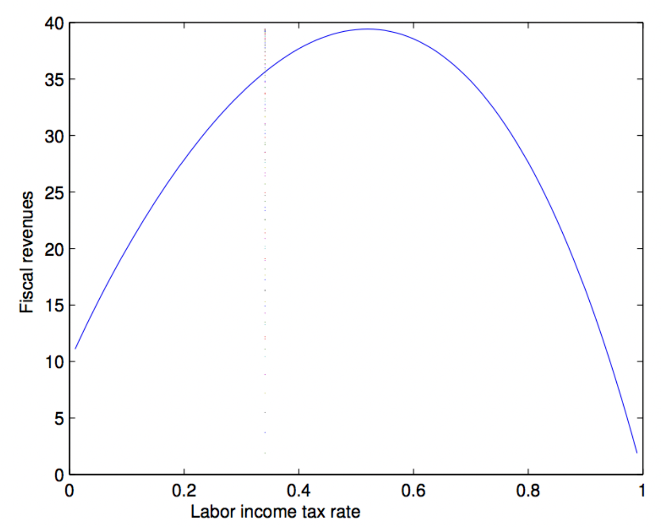
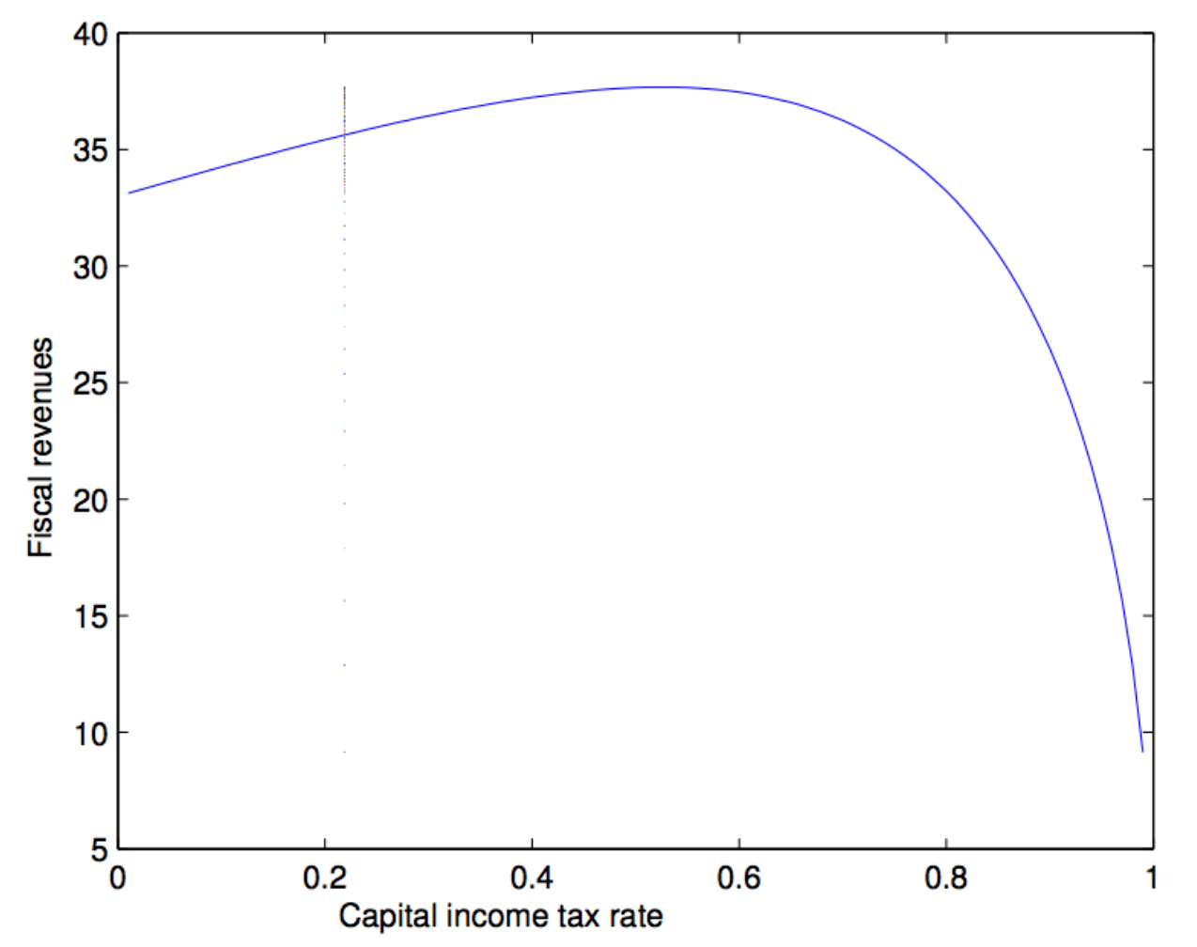
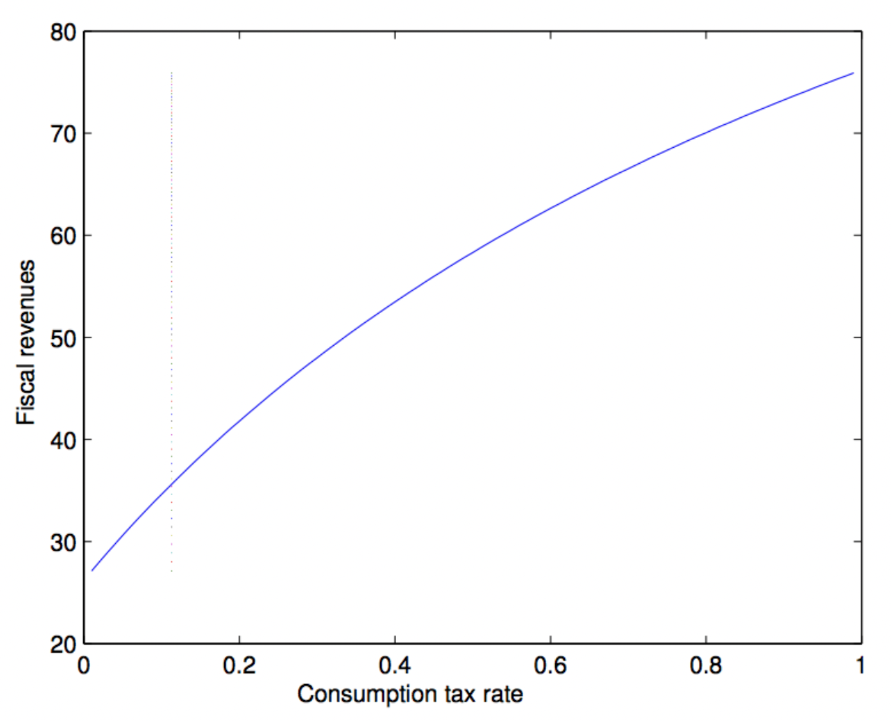
5. The Laffer Curve

Slide 26


https://www.dynare.org/ https://www.dynare.org/resources/quick_start/

Slide 27
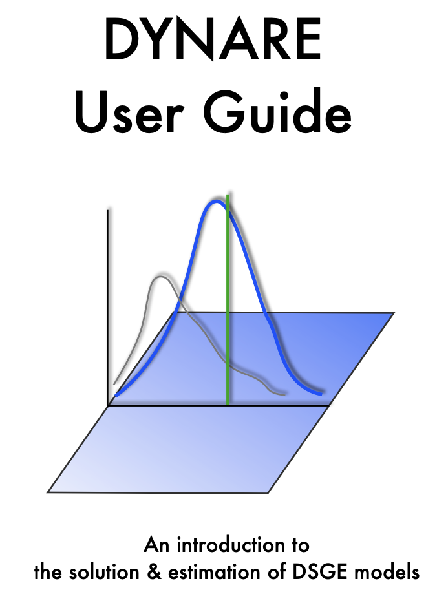
https://www.sfu.ca/~kkasa/UserGuide.pdf

Slide 28
// Endogenous variables
var Y, C, I, F, K, L, R, W, A;
// Exogenous variables
varexo e;
// Parameters
parameters alpha, beta, delta, gamma, rho, tauc, tauk, taul;
tauk_s = linspace(0,0.95,20);
for i = 1:20;
tauk = tauk_s(i);
// Calibrated parameters
alpha = 0.35;
beta = 0.97;
delta = 0.06;
gamma = 0.40;
rho = 0.95;
tauc = 0.116;
taul = 0.344;
// Equations of the model
model;
(1+tauc)*C=(gamma/(1-gamma))*(1-L)*(1-taul)*W;
1 = beta*((((1+tauc)*C)/((1+tauc(+1))*C(+1)))*((1-tauk)*(R(+1)-delta)+1));
Y = A*(K(-1)^alpha)*(L^(1-alpha));
K = I+(1-delta)*K(-1);
I = Y-C;
W = (1-alpha)*A*(K(-1)^alpha)*(L^(-alpha));
R = alpha*A*(K(-1)^(alpha-1))*(L^(1-alpha));
F = tauc*C+taul*W*L+tauk*(R-delta)*K;
log(A) = rho*log(A(-1))+ e;
end;
// Initial values
initval;
Y = 1;
C = 0.8;
L = 0.3;
K = 3.5;
I = 0.2;
W = (1-alpha)*Y/L;
R = alpha*Y/K;
A = 1;
e = 0;
end;

Slide 29
steadystate.Var2 = [];
for i = 1:20;
ss = ['steadystate.ss',num2str(i)];
eval([ss,'=', ['steadystate_',num2str(i)]]);
end;
steadystate(:,1) = [];
steadystateArray = table2array(steadystate);
steadystate_tr = array2table(steadystateArray.','VariableNames',{'tau_c';'tau_k';'tau_l';'Y';'C'; 'I'; 'F'; 'K'; 'L'; 'R';'W';'A'});
writetable(steadystate_tr,'ss_tauk.xlsx');
// Figures
figure;
plot(steadystate_tr.tau_k,steadystate_tr.F,'LineWidth',3);
xlabel(['$\tau_{k}$'],'interpreter','latex','FontSize',20);
ylabel('Fiscal income F','FontSize',18);
title('Laffer curve for capital income tax','FontSize',20)
hold on;
plot([0.225; 0.225],[min(steadystate_tr.F) max(steadystate_tr.F)],'--','LineWidth',2)
// calculate steady state
steady;
// save steady states to a vector
names = ["tau_c";"tau_k";"tau_l";"总产出Y";"总消费C"; "总投资I"; "总税收F"; "总资本K"; "总劳动L"; "利率R";"工资率W";"技术水平A"];
steadystate = table(names,[tauc;tauk;taul;oo_.steady_state]);
eval(['steadystate_',num2str(i),'=[tauc;tauk;taul;oo_.steady_state]’]);
end;

Slide 30
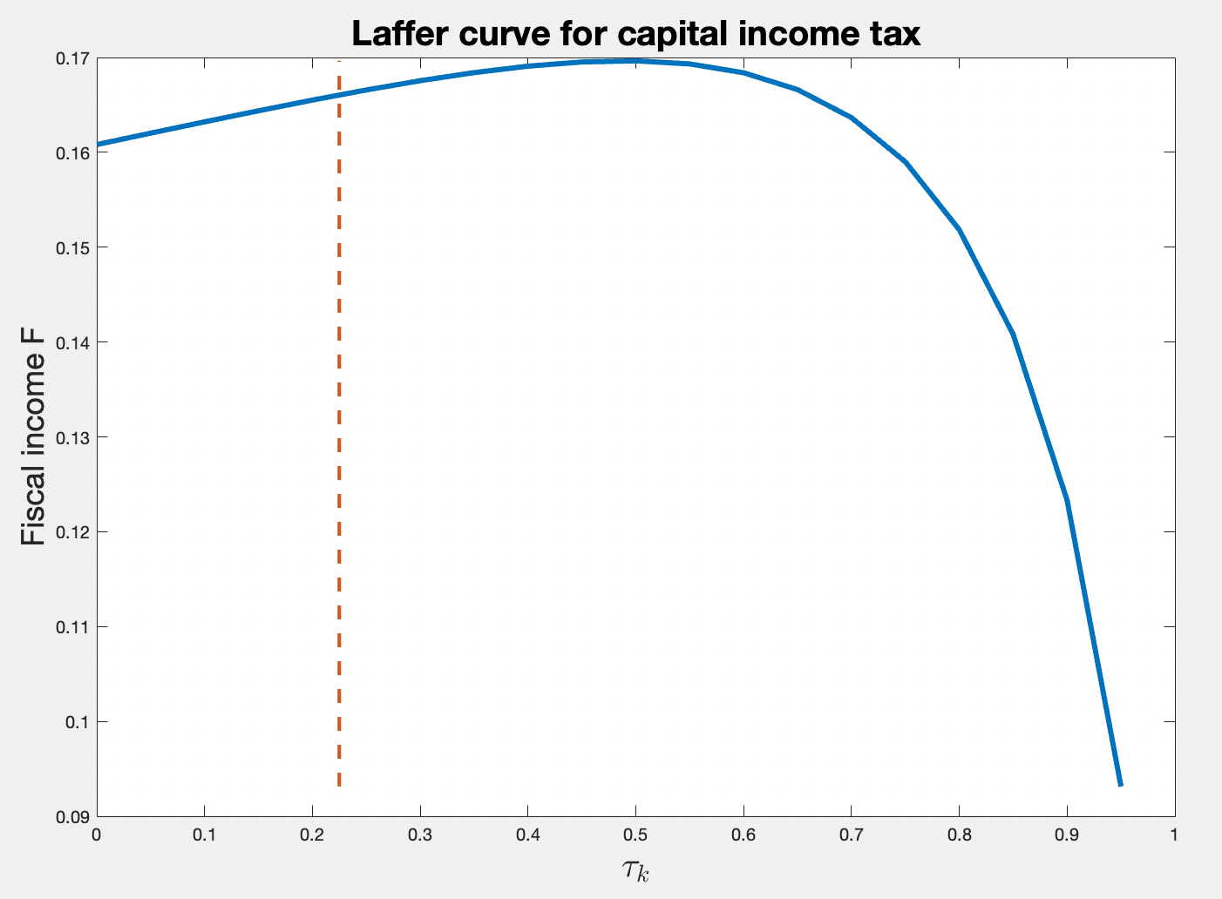
laffer_k.mod

Slide 31
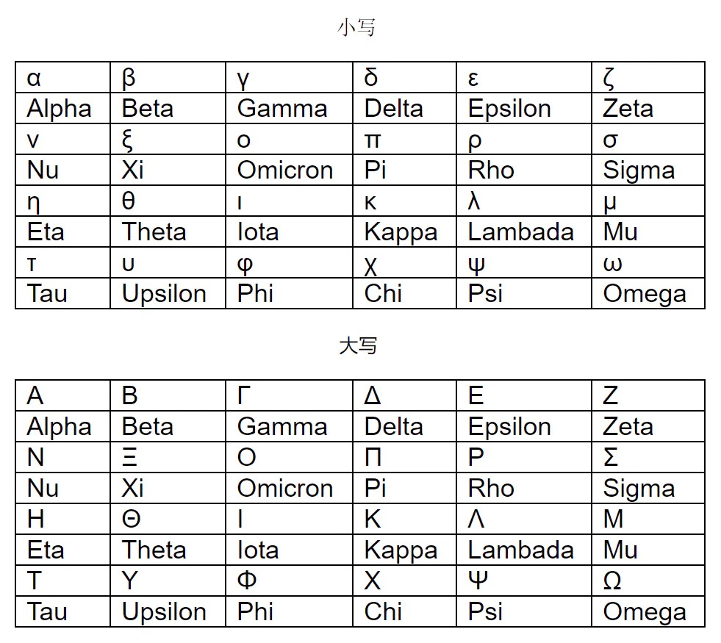

Slide 32
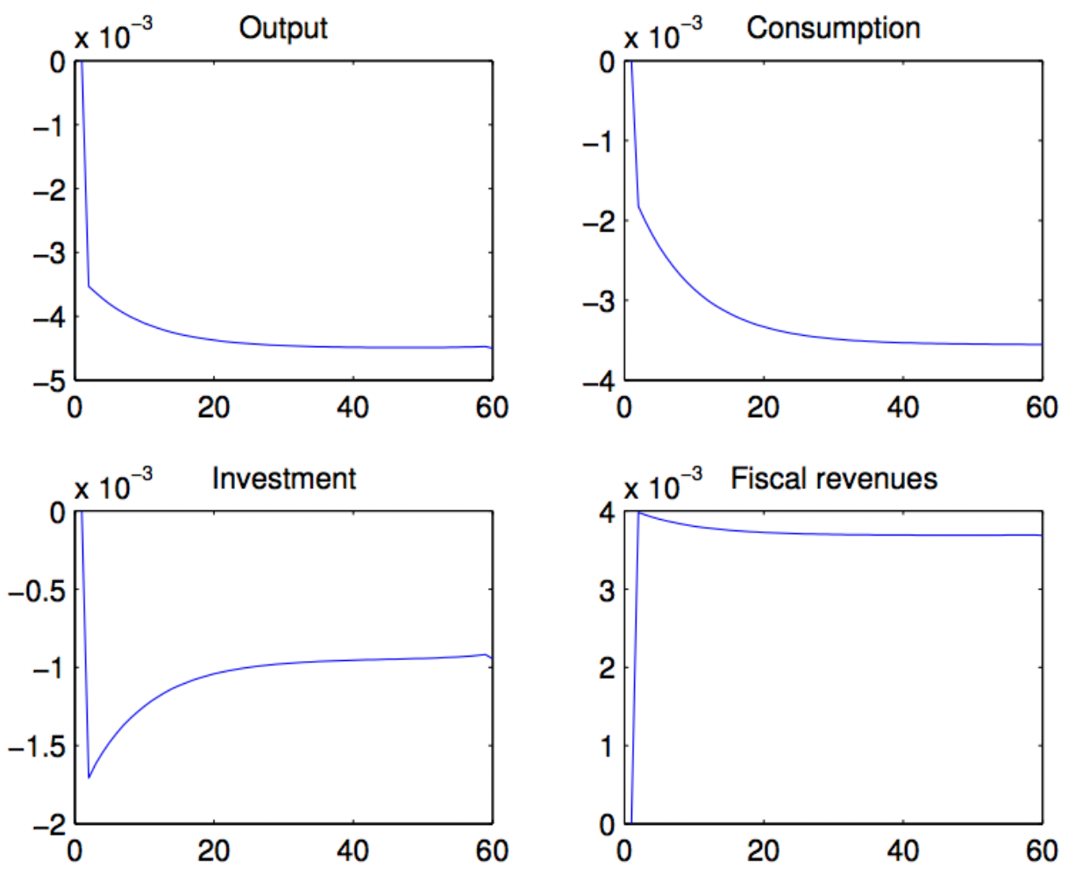
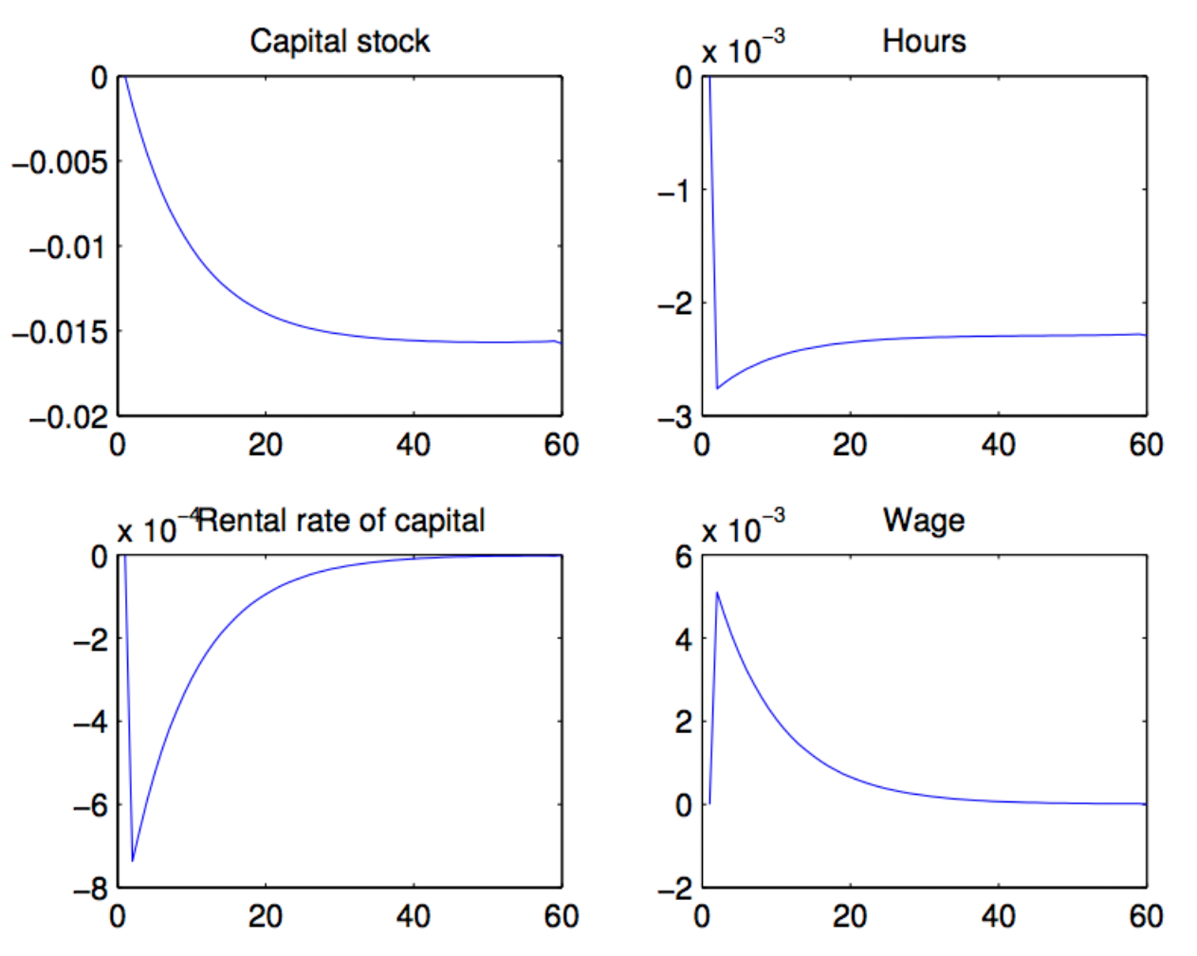
6. Tax changes
Figure. Unanticipated permanent increases in consumption tax
model6a.mod

Slide 33
// Endogenous variables
var Y, C, I, G, K, L, R, W, A;
// Exogenous variables
varexo e, tauc, taul, tauk;
// Parameters
parameters alpha, beta, delta, gamma, rho;
// Calibrated parameters
alpha = 0.35;
beta = 0.97;
delta = 0.06;
gamma = 0.40;
rho = 0.95;
// Equations of the model
model;
(1+tauc)*C=(gamma/(1-gamma))*(1-L)*(1-taul)*(1-alpha)*Y/L;
1 = beta*((((1+tauc)*C)/((1+tauc(+1))*C(+1)))*((1-tauk)*(R(+1)-delta)+1));
Y = A*(K(-1)^alpha)*(L^(1-alpha));
K = I+(1-delta)*K(-1);
I = Y-C;
W = (1-alpha)*A*(K(-1)^alpha)*(L^(-alpha));
R = alpha*A*(K(-1)^(alpha-1))*(L^(1-alpha));
G = tauc*C+taul*W*L+tauk*(R-delta)*K(-1);
log(A) = rho*log(A(-1))+ e;
end;
// Initial values
initval;
Y = 1;
C = 0.8;
L = 0.3;
K = 3.5;
I = 0.2;
W = (1-alpha)*Y/L;
R = alpha*Y/K;
A = 1;
e = 0;
tauc = 0.116;
tauk = 0.225;
taul = 0.344;
end;
steady;
SS0=oo_.steady_state;
// Blanchard-Kahn conditions
check;
// Final values
endval;
Y = 1;
C = 0.8;
L = 0.3;
K = 3.5;
I = 0.2;
W = (1-alpha)*Y/L;
R = alpha*Y/K;
A = 1;
e = 0;
tauc = 0.130;
tauk = 0.225;
taul = 0.344;
end;
steady;
// Disturbance: change in the consumption tax
shocks;
var tauc;
// Period of the change
periods 0;
// Change is the tax rate with respect to the final value
values 0;
end;
// Deterministic simulation
simul(periods=58);

Slide 34
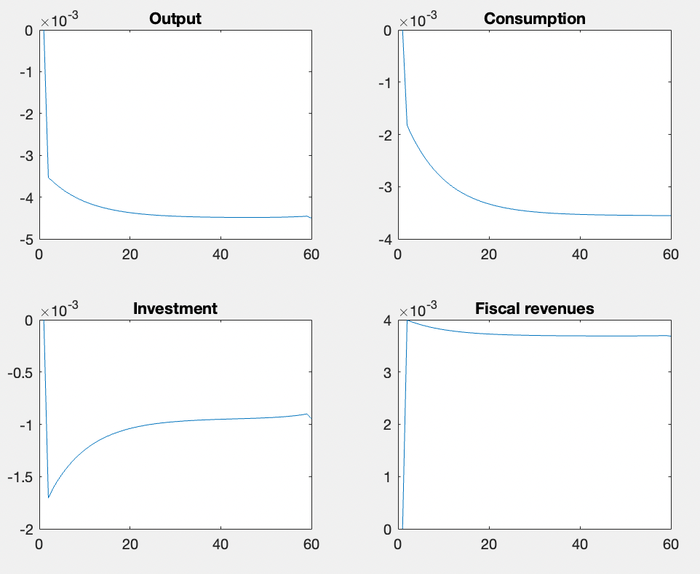
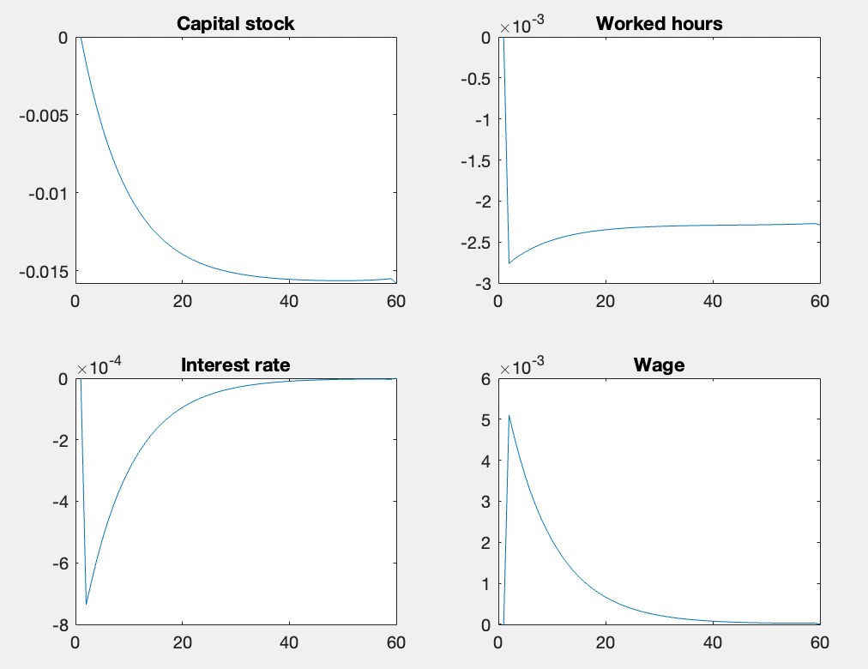
model6a.mod

Slide 35
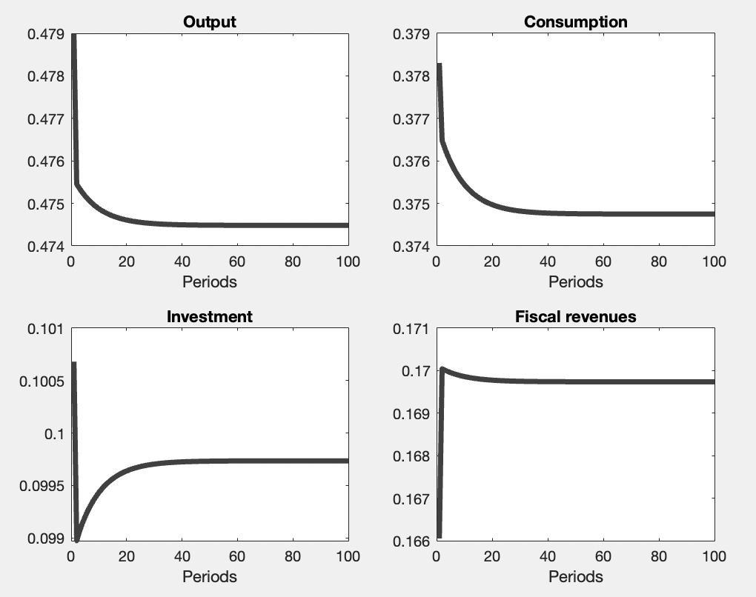
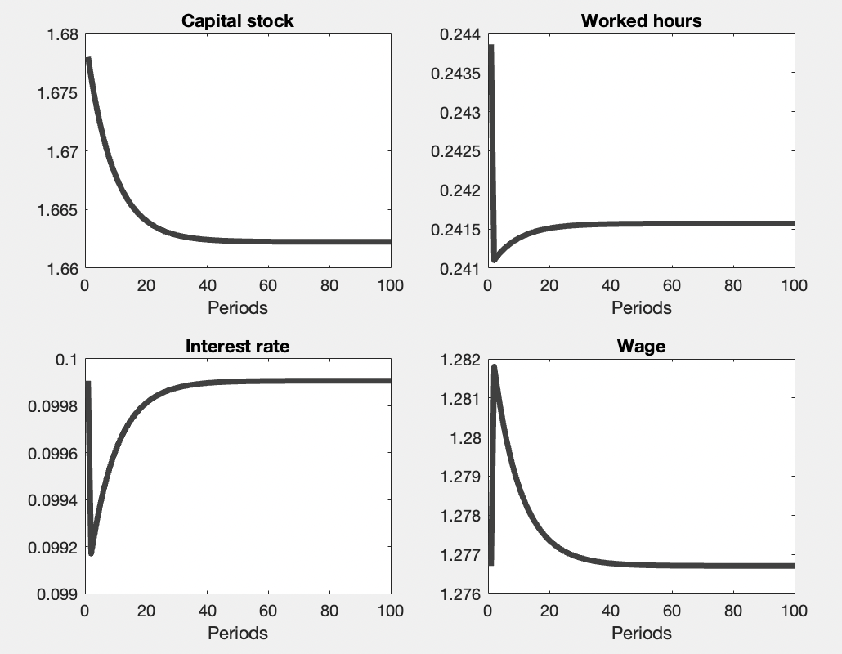
Figure. Unanticipated permanent increases in consumption tax
model6c.mod

Slide 36
// Endogenous variables
var Y, C, I, F, K, L, R, W, A;
// Exogenous variables
varexo e, tauc, taul, tauk;
// Parameters
parameters alpha, beta, delta, gamma, rho;
// Calibrated parameters
alpha = 0.35;
beta = 0.97;
delta = 0.06;
gamma = 0.40;
rho = 0.95;
// Equations of the model
model;
(1+tauc)*C=(gamma/(1-gamma))*(1-L)*(1-taul)*W;
1 = beta*((((1+tauc)*C)/((1+tauc(+1))*C(+1)))*((1-tauk)*(R(+1)-delta)+1));
Y = A*(K(-1)^alpha)*(L^(1-alpha));
K = I+(1-delta)*K(-1);
I = Y-C;
W = (1-alpha)*A*(K(-1)^alpha)*(L^(-alpha));
R = alpha*A*(K(-1)^(alpha-1))*(L^(1-alpha));
F = tauc*C+taul*W*L+tauk*(R-delta)*K(-1);
log(A) = rho*log(A(-1))+ e;
end;
// Initial values
initval;
Y = 1;
C = 0.8;
L = 0.3;
K = 3.5;
I = 0.2;
W = (1-alpha)*Y/L;
R = alpha*Y/K;
A = 1;
e = 0;
tauc = 0.116;
tauk = 0.225;
taul = 0.344;
end;
// calculate steady state
steady;
// save steady states to a vector SS0
SS0=oo_.steady_state;
// Blanchard-Kahn conditions
check;

Slide 37
// Final steady state values from model6b.mod
endval;
Y = 1;
C = 0.8;
L = 0.3;
K = 3.5;
I = 0.2;
W = (1-alpha)*Y/L;
R = alpha*Y/K;
A = 1;
e = 0;
tauc = 0.130;
tauk = 0.225;
taul = 0.344;
end;
// calculate steady state
steady;
// save steady states to a vector SS1
SS1=oo_.steady_state;
// Deterministic simulation
simul(periods=98);
// Figures
T=100;
j=1:T;
subplot(2,2,1)
plot(j,Y,'Color',[0.25 0.25 0.25],'linewidth',3.5)
xlabel('Periods')
title('Output per capita’)
subplot(2,2,2)
plot(j,C,'Color',[0.25 0.25 0.25],'linewidth',3.5)
xlabel('Periods')
title('Consumption');
subplot(2,2,3)
plot(j,I,'Color',[0.25 0.25 0.25],'linewidth',3.5)
xlabel('Periods')
title('Investment');
subplot(2,2,4)
plot(j,F,'Color',[0.25 0.25 0.25],'linewidth',3.5)
xlabel('Periods')
title('Fiscal revenues');

Slide 38
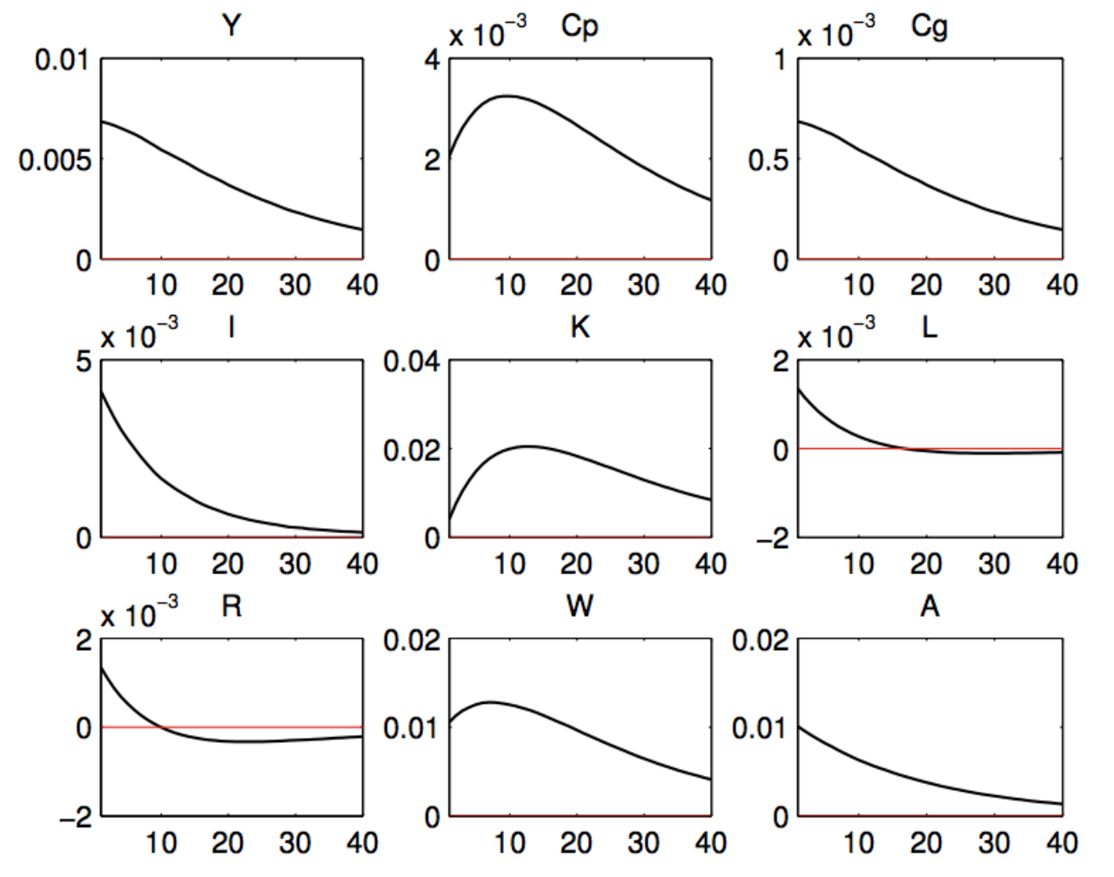
7. TFP Shock
The distortionary effects caused by taxes are represented by the result that a positive productivity shock on the economy have less expansionary effects compared to a situation without taxes.
Figure. A positive TFP shock with taxes

Slide 39
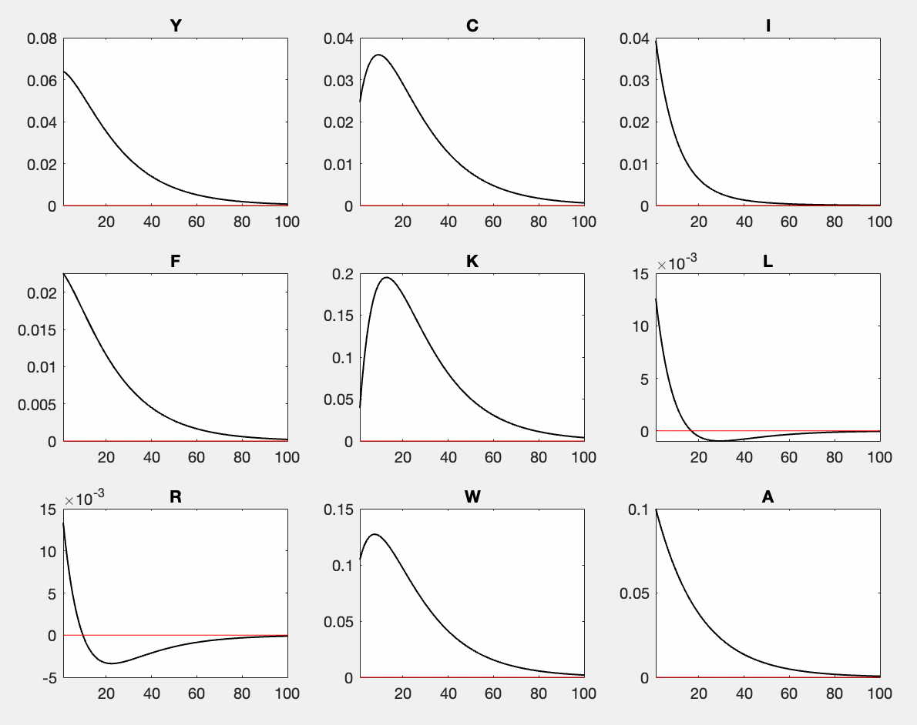
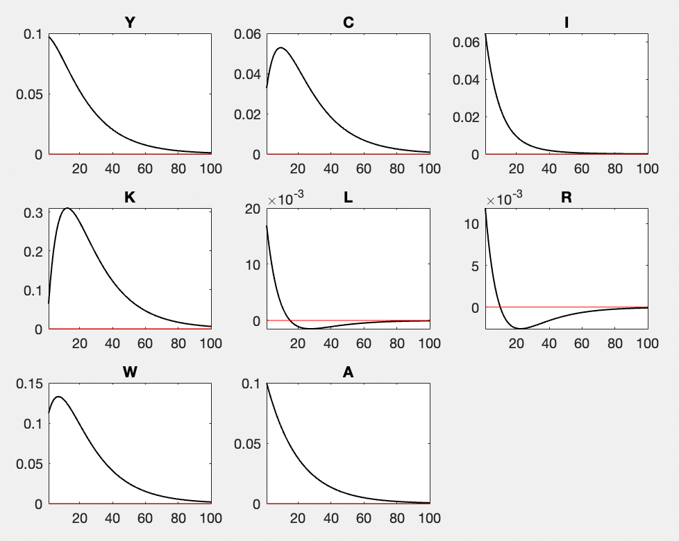
model.mod
var e; stderr 0.1;tauc = 0.116; tauk = 0.225;taul = 0.344;
var e; stderr 0.1;tauc = 0; tauk = 0;taul = 0;

Slide 40
// Endogenous variables
var Y, C, I, F, K, L, R, W, A;
// Exogenous variables
varexo e, tauc, taul, tauk;
// Parameters
parameters alpha, beta, delta, gamma, rho;
// Calibrated parameters
alpha = 0.35;
beta = 0.97;
delta = 0.06;
gamma = 0.40;
rho = 0.95;
// Equations of the model
model;
(1+tauc)*C=(gamma/(1-gamma))*(1-L)*(1-taul)*W;
1 = beta*((((1+tauc)*C)/((1+tauc(+1))*C(+1)))*((1-tauk)*(R(+1)-delta)+1));
Y = A*(K(-1)^alpha)*(L^(1-alpha));
K = I+(1-delta)*K(-1);
I = Y-C;
W = (1-alpha)*A*(K(-1)^alpha)*(L^(-alpha));
R = alpha*A*(K(-1)^(alpha-1))*(L^(1-alpha));
F = tauc*C+taul*W*L+tauk*(R-delta)*K;
log(A) = rho*log(A(-1))+ e;
end;
// calculate steady state
steady;
// save steady states to a
// vector SS0
SS0=oo_.steady_state;
writetable(SS0,'SS0.xlsx');
// Blanchard-Kahn conditions
check;
// TFP shock
shocks;
var e; stderr 0.1;
end;
% Stochastic simulation
stoch_simul(order= 1, irf=100);
// Initial values
initval;
Y = 1;
C = 0.8;
L = 0.3;
K = 3.5;
I = 0.2;
W = (1-alpha)*Y/L;
R = alpha*Y/K;
A = 1;
e = 0;
tauc = 0.116;
tauk = 0.225;
taul = 0.344;
end;

Slide 41
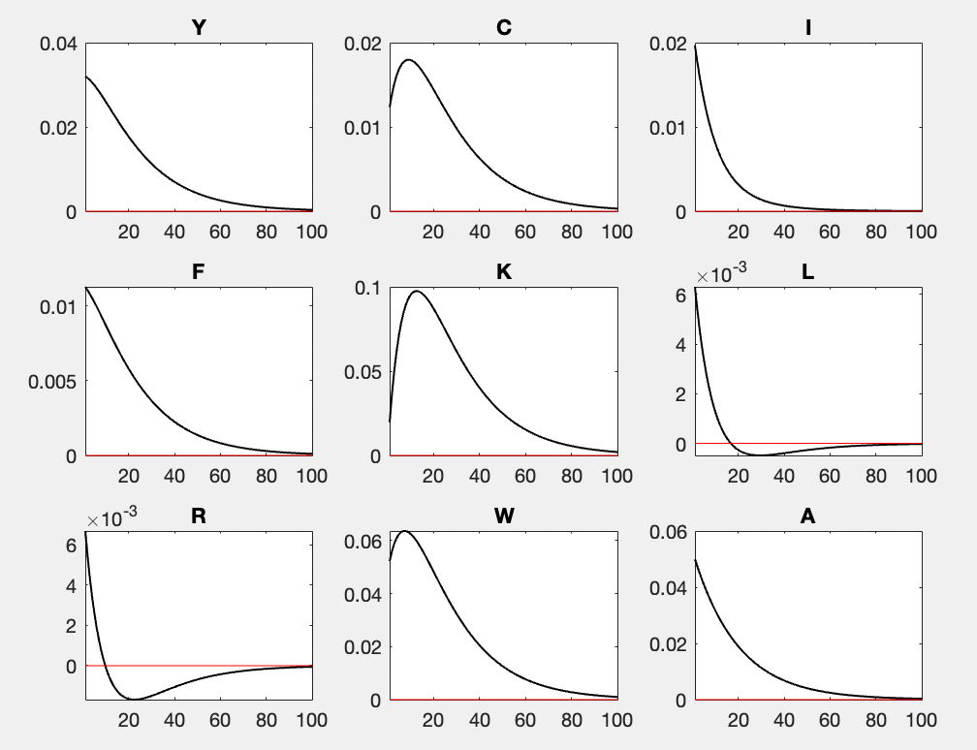
model.mod
var e; stderr 0.1;tauc = 0.116; tauk = 0.225;taul = 0.344;
var e; stderr 0.05;tauc = 0.116; tauk = 0.225;taul = 0.344;

Slide 42
4. Equations of the model and calibration
The competitive equilibrium of the model economy is defined by a set of eight equations, representing the dynamics of 7 endogenous variables, $Y_{t}, C_{t}, I_{t}$, $K_{t}$, $L_{t}$, $R_{t}$,$W_{t}$, and the total factor productivity $A_{t}$ and where three additional exogenous variables are included: $τ_{ct}$, $τ_{lt}$, $τ_{kt}$.
This set of equations is the following:
$\frac{1}{1−L_{t}}=\frac{γ}{1−γ}\frac{\left(1−τ_{l}\right)}{\left(1+τ_{c}\right)}\frac{W_{t}}{C_{t}}$
$\frac{C_{t+1}\left(1+τ_{c,t+1}\right)}{C_{t}\left(1+τ_{c,t}\right)}=β\left[\left(1−τ_{k}\right)\left(R_{t}−δ\right)+1\right]$
$Y_{t}=C_{t}+I_{t}$
$Y_{t}=A_{t}K_{t}^{α}L_{t}^{1−α}$
$K_{t+1}=I_{t}+\left(1−δ\right)K_{t}$
$W_{t}=(1−α)A_{t}K_{t}^{α}L_{t}^{−α}$
$R_{t}=αA_{t+1}K_{t+1}^{α−1}L_{t+1}^{1−α}$
$\ln{A_{t}}=\left(1−ρ_{A}\right)\ln{\overline{A}}+ρ_{A}\ln{A_{t−1}}+ε_{t}^{A}, where {0<ρ}_{A}<1.$
The model parameters to be calibrated are:

Slide 43
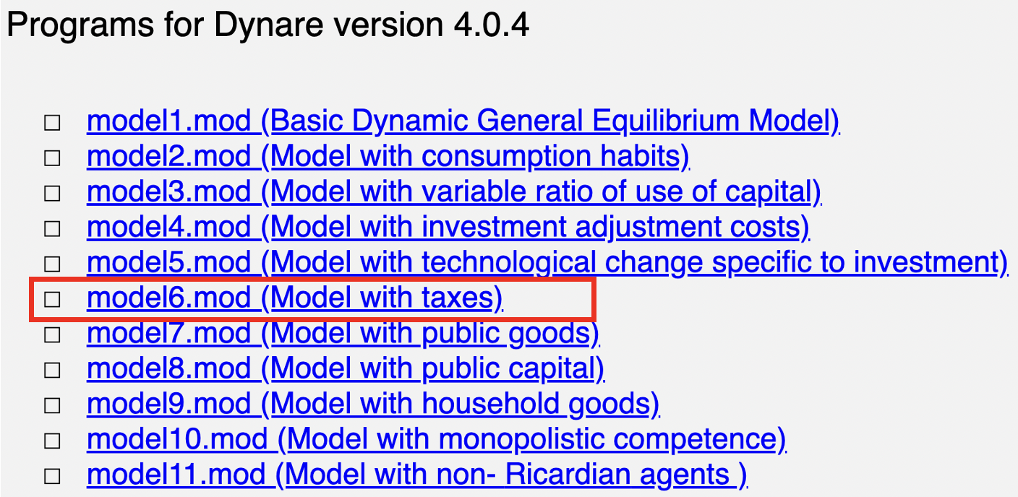
Dynare Codes Source
Joseph Louis Torres, University of Malaga ( Spain )
Introduction to Dynamic Macroeconomic General Equilibrium Models
http://webpersonal.uma.es/de/jtorres/jtorres.htm

Slide 44
8. Conclusions
In this lecture we have introduced taxes in the DSGE model, which means the introduction of the government, in addition to households and firms.
We show that for a particular calibrated economy, using this DSGE model is very easy for the computation of Laffer curves for each type of tax, and for the whole fiscal system.
We have studied the effects of changes in various taxes.
This exercise can be done considering both permanent and temporary changes, and both anticipated and non-anticipated changes.
We analyzed the effects of an aggregate productivity shock on the economy when taxes are in place.
The distortionary effects caused by taxes:
a positive productivity shock on the economy have less expansionary effects compared to a situation without taxes.

Slide 45
Homework
Plot the Laffer curve for labor income tax with the DSGE codes.
Plot the transition path for unanticipated permanent increases in capital tax by 20% and unanticipated permanent decreases in labor tax by 10% simultaneously.
Plot the impluse response functions of TFP shocks (var e; stderr 0.15;) with the new tax rates in question 2.

Slide 46


Slide 47


Slide 48


